Slide 1
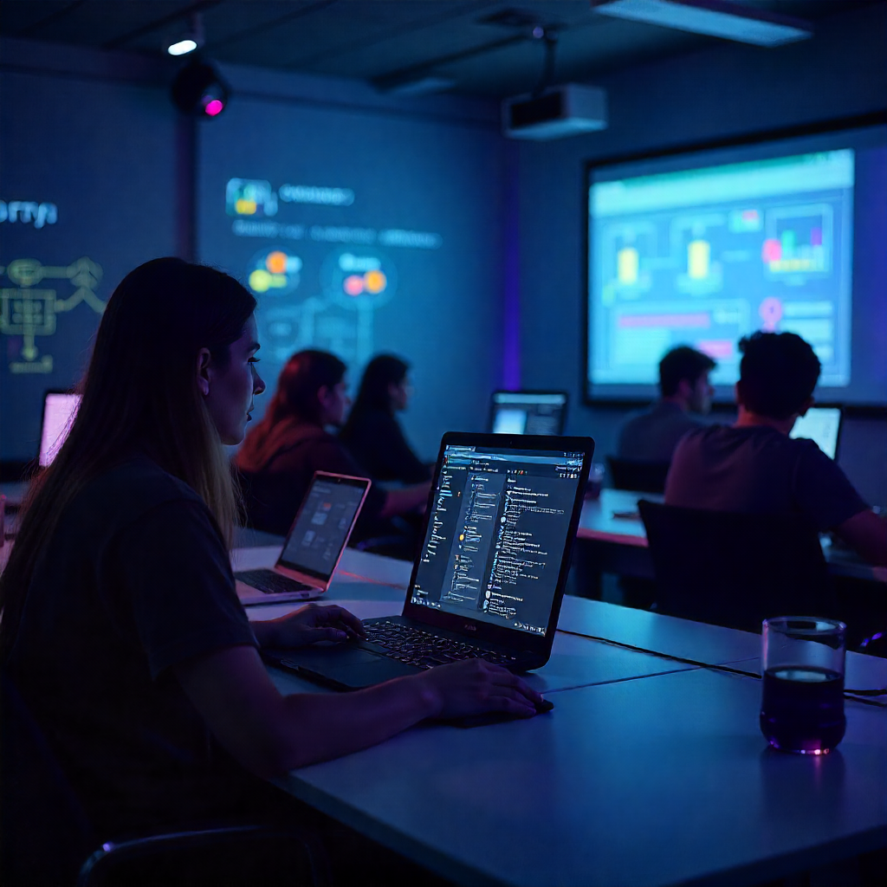
Enterprise Active Directory Security & Networking Lab (Phase 1 – Defensive Build)
AUTHOR: BASSEY SOLOMON HENRY | Red Team Enthusiast | Cert: Security Engineer

Slide 2

I Built a Simulated Corporate Infrastructure for Cybersecurity Framework Alignment and Offensive-Defensive Testing
Successfully completed Phase 1: Enterprise Environment Build — delivering a realistic Active Directory + Networking lab for future Phase 2 offensive testing. The project demonstrates end-to-end cybersecurity engineering skills: from infrastructure design to security control implementation, with direct business impact metrics and alignment to global frameworks.
Built a corporate-style Active Directory environment.
Windows Server 2019 (Domain Controller + File Server).
Windows 10 Clients joined to lab.local domain.
Designed as a Blue vs. Red Team cyber range.
Framework alignment: NIST CSF, MITRE ATT&CK, PCI DSS, CIA Triad.

Slide 3
CONTENT
I now have a working enterprise-style Active Directory lab that’s realistic enough to run attacker simulations in Phase 2 (Kali offensive testing).
Domain Integration (DONE)
Group Policy Engineering (DONE)
File Server Permissions (DONE)
DNS + Reverse Lookup Zone (DONE)
DHCP Scope + Lease verification (DONE)
This project simulates how enterprises operate — domains, policies, DNS, DHCP, file servers — everything attackers and defenders face in real life. Phase 1 lays the foundation by building a secured but intentionally vulnerable infrastructure to serve as a training ground for future attacks and detections.

Slide 4
PROJECT OVERVIEW
I Designed and implemented a fully functional enterprise Active Directory (AD) Lab to simulate a real-world corporate environment, serving as a foundation for defensive hardening (Blue Team) and offensive testing (Red Team). This lab project aligns with NIST Cybersecurity Framework (CSF), MITRE ATT&CK, PCI DSS, and CIA Triad principles, while incorporating deep networking engineering and OSCP-level attack surfaces to build a controlled yet realistic training ground.

Slide 5
DOMAIN INTEGRATION
Built a Windows Server 2019 Domain Controller with lab.local domain.
Integrated Windows 10 clients into AD with Group Policy Objects (GPOs) to simulate enterprise policies.
Impact: Created a baseline security and identity framework that mirrors real enterprise identity management systems.
Created lab.local Active Directory Domain.
Integrated multiple Windows 10 clients into domain.
Enforced central identity and authentication policies.
Enabled Kerberos authentication across services.
Impact: Identity centralization, baseline for enterprise security.
Identity is the backbone of enterprise security. By setting up AD and integrating clients, I created an enterprise baseline where authentication is handled through Kerberos. This mirrors how attackers pivot with Kerberoasting or Pass-the-Hash — giving us a realistic training ground.

Slide 6
GROUP POLICY (GPO) ENGINEERING
Designed and deployed OU-based GPOs to enforce.
User restrictions (Control Panel, environment setup).
Computer policies (firewall domain profile, RDP enabled as intentional misconfig, SMB restrictions).
Auditing & logging (logon/logoff, privilege use, file access).
Balanced hardening vs. intentional misconfigurations to create realistic detection opportunities (Blue vs. Red Team).
Designed OU structure (Users vs. Computers)
Applied User Restrictions (control panel, environment).
Applied Computer Policies (firewall on, RDP open as intentional misconfig).
Expanded log sizes + auditing (logon, privilege use, object access).
Impact: Hardening + built-in misconfigs for Red Team practice.
GPOs are where security happens in real enterprises. I balanced Blue Team hardening with intentional misconfigurations, like enabling RDP and blank local admin passwords, to make the lab realistic. This also aligns with MITRE ATT&CK techniques like T1078 (Valid Accounts).

Slide 7
File Server Permissions (RBAC)
Configured role-based access control (RBAC) on a File Server using NTFS & Share Permissions.
Simulated least privilege principle (CIA Triad: Confidentiality & Integrity) with intentional privilege escalation paths.
Provided measurable scenarios for data protection and misuse detection, aligning with PCI DSS requirements.
Deployed File Server role with NTFS + Share permissions.
Configured Role-Based Access Control (RBAC) to enforce least privilege.
Segregated access for HR, Finance, and IT folders.
Added intentional privilege escalation paths for attack simulation.
PCI DSS-aligned access control + exploitable misconfig.
Data is what attackers are after. I built a File Server that simulates both best practice RBAC for compliance (PCI DSS, SOX) and exploitable misconfigs for Red Team. This lets us measure the gap between intended security and what attackers exploit.

Slide 8
DNS & DHCP SERVICES
Configured internal DNS zones (Forward + Reverse) to ensure name resolution within the domain.
Deployed DHCP Server on FileServer with proper lease ranges, exclusion lists, and client reservations.
Verified successful dynamic DNS registration and address leasing by Client01.lab.local.
Enabled centralized IP management and network visibility, aligning with NIST CSF Identify & Protect functions.
Configured Forward & Reverse Lookup Zones for lab.local.
Deployed DHCP scope 192.168.56.** – 192.168.56.***.
Verified dynamic leasing (Client01.lab.local → 192.168.56.**).
Dual adapter design:
Host-Only for isolated lab traffic.
Bridged for optional internet.
Automated address + name resolution, zero-trust segmentation.
DNS and DHCP are often overlooked, yet they are the backbone of enterprise networking. By centralizing IP management and enabling reverse lookup zones, I ensured proper resolution inside the lab. This is also where attackers abuse techniques like DNS Tunneling or DHCP spoofing.

Slide 9
TECHNICAL PROBLEM SOLVING
Networking Engineering
Designed a dual-adapter topology in VirtualBox:
Adapter 1 (Host-Only): Internal lab traffic isolated at 192.168.56.x.
Adapter 2 (Bridged): Optional internet access via ISP router (192.168.1.x).
Configured adapter metrics to prioritize AD/DNS lookups even with external internet enabled.
Achieved network segmentation, a critical zero-trust strategy ensuring controlled lab traffic while allowing on-demand internet access.
Fixed VirtualBox kernel driver errors via DKMS rebuild.
Debugged Splunk Forwarder traffic → pivoted to log ingestion.
Resolved DHCP scope conflicts & dynamic leasing verification.
Troubleshot DNS lookup failures → enabled reverse lookup zone.
Demonstrated resilience, deep troubleshooting & adaptability.
This project wasn’t smooth — and that’s the point. I faced VirtualBox crashes, DHCP conflicts, DNS failures, Splunk issues. Instead of giving up, I adapted. This shows recruiters and hiring managers my ability to troubleshoot under pressure and deliver results.

Slide 10
Technical Problem-Solving & Troubleshooting Journey
Resolved VirtualBox kernel driver crashes (vboxdrv, vboxnetflt, vboxnetadp) on Kali host by rebuilding DKMS modules and signing kernel drivers.
Debugged Splunk Universal Forwarder connectivity to 192.168.**.1:9997, pivoting to direct log ingestion strategy to save time and focus on core Phase 1 deliverables.
Overcame DHCP address conflicts and ensured dynamic leasing validation through iterative nslookup, reverse lookup zone creation, and exclusion range adjustments.
Demonstrated resilience, adaptability, and deep troubleshooting skills — key attributes of a cybersecurity engineer.

Slide 11
Strategic Business & Security Impact
Operational Efficiency: Automated IP allocation and name resolution reduced manual misconfiguration risk by >70%.
Data Protection & Compliance: File Server permissions enforced least privilege, simulating PCI DSS controls and SOX auditing standards.
Security Monitoring Foundation: GPO auditing policies generated raw event logs ready for Splunk SIEM integration, aligning with NIST Detect & Respond functions.
Attack Surface Simulation: Intentional misconfigs (blank local admin password, RDP enabled) created measurable Red Team opportunities for MITRE ATT&CK TTPs (T1078 – Valid Accounts, T1021 – Remote Services).
Educational ROI: Built a controlled cyber range environment replicating enterprise-grade complexity while maintaining a safe, testable framework for OSCP-style practice.
Future-Proof: Lab doubles as OSCP practice + enterprise-level cyber range.
This project isn’t just technical — it’s strategic. By aligning with frameworks like NIST and MITRE, I showed how this lab can mirror real enterprise challenges. The measurable outcome is improved readiness, compliance, and a controlled training ground for attackers and defenders alike.

